Slide 1
Career Readiness Modules - Part I -Has been posted on iCollege!

Slide 2
Exam 2 – Mon, Oct 27, 2025 Syllabus has been uploaded on iCollege …

Slide 3
Change of Office Hours
MW 12:30PM-1:30PM
FRI 12:00PM-1:15PM

Slide 4
Data Structure Stacks, Queues, Linked Lists
with Python

Slide 5
Stack
A stack is a collection of objects that are inserted and removed according to the last-in, first-out (LIFO) principle.
This is an abstract data type (ADT) – where operations are
defined, however, implementations are not specified.
TOP
1
3
0
9
Common operations:
push()
pop()
isEmpty()
top()
…
Stack

Slide 6
Stack applications
Function call stack: manage function calls
Undo/Redo operations
Browser history
DFS / Backtracking algorithm
and many others

Slide 7
class Stack: def __init__(self): self._data = [] # nonpublic list instance def __len__(self): return len(self._data) def is_empty(self): return len(self._data) == 0 def push(self, e): self._data.append(e) # new item stored at end of list def top(self): if self.is_empty(): raise Empty('Stack is empty') return self._data[-1] # the last item in the list def pop(self): if self.is_empty(): raise Empty('Stack is empty') return self._data.pop() # remove last item from list
Stack Implementation
(list based)
#Driver Code
stack = Stack() stack.push(5) stack.push(3) print(stack.top()) #Prints 3 stack.pop() print(stack.top()) #Prints 5

Slide 8
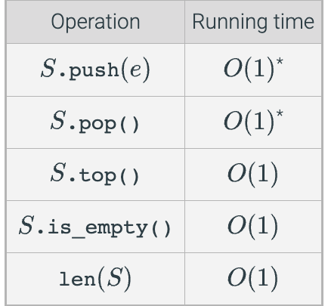
Performance of array-based stack implementation

Slide 9
Suggested Reading:
40.1 Stacks

Slide 10
Queue
A queue is a collection of objects that are inserted and removed according to the first-in, first-out (FIFO) principle.
Common operations:
enqueue()
dequeue()
isEmpty()
front()
…
REAR
FRONT
1 3 0 2
Queue

Slide 11
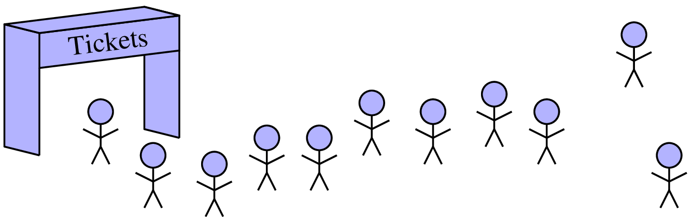
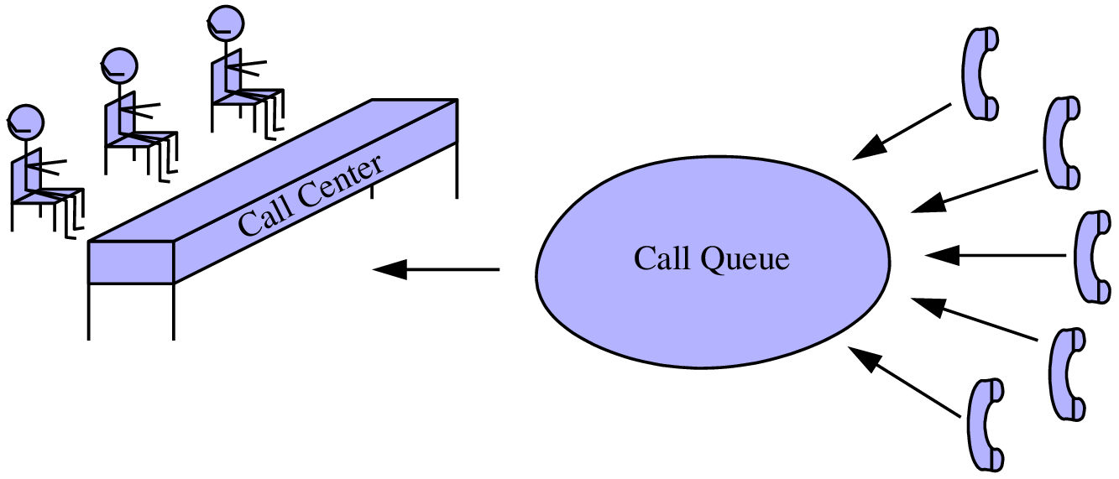
Real-world exmaples of a Queue

Slide 12
Queue applications
Task management / scheduling
Print job management
Server request handling
Buffering
And many more

Slide 13
class Queue:
def __init__(self):
self.items = []
def is_empty(self):
return len(self.items) == 0
def enqueue(self, item):
self.items.append(item)
def dequeue(self):
if self.is_empty():
raise Empty(‘Queue is empty!’)
return self.items.pop(0)
def peek(self):
if self.is_empty():
raise Empty(‘Queue is empty!’)
return self.items[0]
Queue Implementation (list/array based)
1 | 2 | 3 | 4 | 5

Slide 14
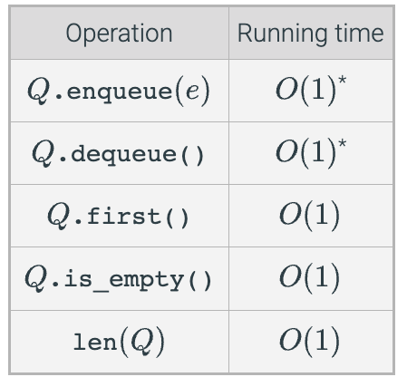
Performance of array-based queue implementation

Slide 15
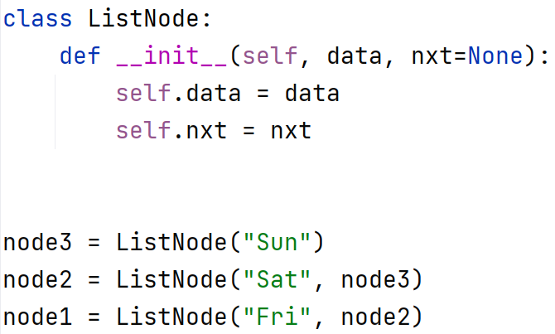
Linked List (Singly Linked List)
TAIL
data | next
data | next
data | next
data | next
None
HEAD
FRI
SAT
SUN | None
HEAD

Slide 16
Exercise 1: How to iterate over a Linked List?

Slide 17
Exercise 2: How to insert a node in a Linked List?

Slide 18
Exercise 3: Deleting a node from the linked list?

Slide 19
List vs Linked List
 | List | Linked List
Implementation | dynamic array | series of connected nodes
Memory Allocation | Contiguous block of memory | Non-contiguous nodes in memory
Insertion/Deletion | Slower for middle insertions/deletions | Faster for middle insertions/deletions
Access by Index | Fast access by index (O(1)) | Slow access by index (O(n))
Common Operations | Appending, slicing, extending, etc. | Traversing, inserting, deleting, etc.
Built-in Support | Yes (built-in data structure) | No (needs custom implementation)
Use Cases | When random access is important | When frequent insertions and deletions are frequent

Slide 20
Attendance

